Slide 1
2019-20 Project Information
Chasco Elementary School

Slide 2
Projects Due Monday, December 9, 2019 Each classroom teacher will choose one participant who will compete in the school showcase during the week of December 16th.
Pasco County Showcase
Saturday, February 1, 2020
The top 8 participants will compete in the district showcase.

Slide 3
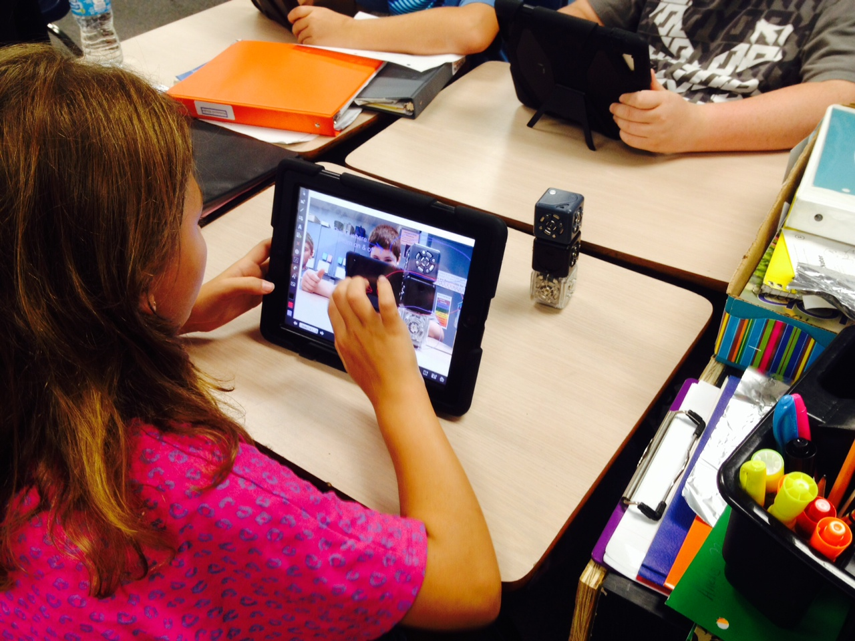
What is STEM?
Science
Technology
Engineering
Mathematics

Slide 4
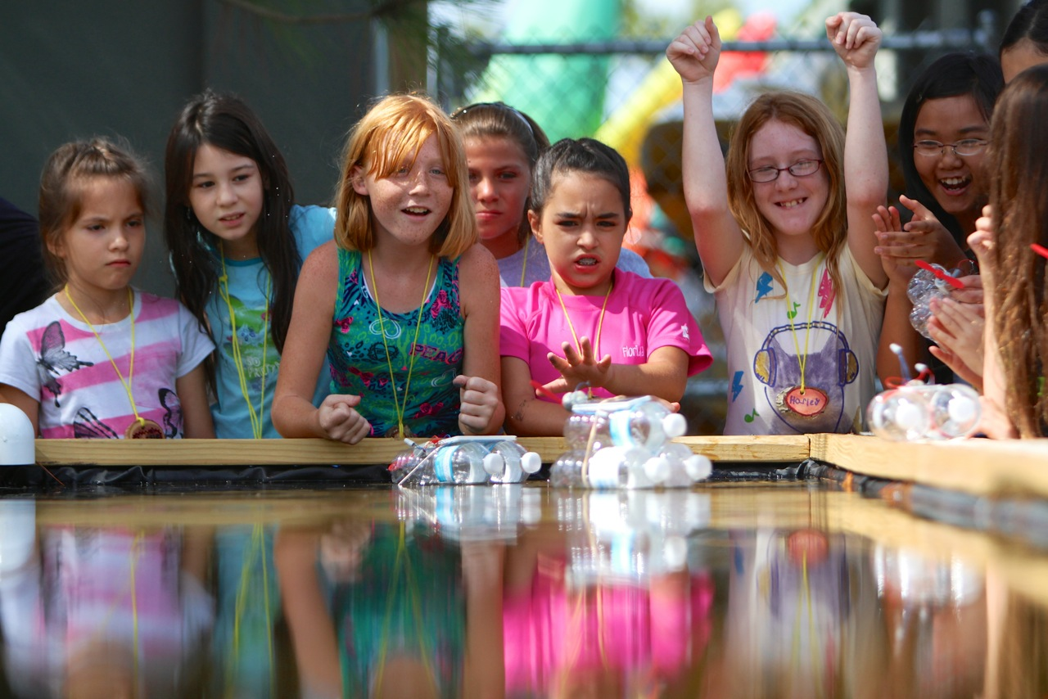
Why a STEM Fair?
Providing students opportunities to make meaningful connections to the real world is critical as we develop the skills, behaviors, and dispositions necessary for college, career, and life readiness.
Developing a S.T.E.M. (Science, Technology, Engineering, and Mathematics) Fair investigation will provide students the opportunity to use science knowledge and skills just as scientists do in the real world.

Slide 5
Skills used in STEM Fair include:
Writing clearly
Communicating information effectively
Collecting and interpreting data
Using evidence to justify your thinking
Managing time
Providing opportunities to ask “why” leading to the development of an experiment or designing of a solution/innovation

Slide 6
Supporting your child with STEM Fair
Parents play a critical role in supporting their child throughout the STEM Fair process.
Be interested, encouraging and positive
Try to ask questions instead of giving answers!
Supervise and use resources that ensure the SAFETY of both your child and tested organisms.

Slide 7
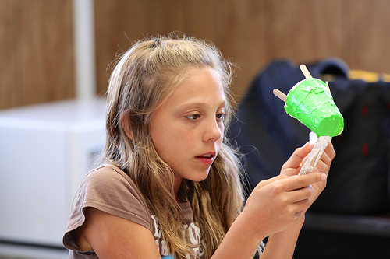
Sample Guiding Questions:
Why?
How do you know that?
What do you want to happen?
What would happen if…?
What other things could you try?
Explain or assist in finding resources to explain concepts that are difficult to understand.

Slide 8
STEM Fair Packet Your child’s teacher provided this packet.
Provides clarification and guidance throughout your child’s investigations.
Helps your child stay organized
Your child WILL need to keep an ADDITIONAL project log or journal. This includes dates and notes of everything that is done and read that pertains to the project.

Slide 9
Getting Started: Choosing an Investigation
Your child can choose to investigate ONE of the following:
Question I am going to answer: “Which brand of diaper is the most absorbent?” (This will be an experiment)
Problem I am going to solve: “I am constantly losing things out of my pant pockets. How can I create a pant pocket that keeps items inside?”
This investigation has the student design/engineer something and then test it to help them solve their problem. (This will be an Invention or Innovation)

Slide 10
If your child chooses to find the answer to a QUESTION, they will follow this sign in the packet.
If your child chooses to solve a PROBLEM, they will follow this sign in the packet.

Slide 11
Step 1: Research
One of the most important parts of the project!
Should be done by creating a list of questions the student wants to learn more about in regards to their investigation topic.
The student can use websites, books, or even talk to professionals
Your child should take notes about their learnings in their lab notebook.

Slide 12
Step 2: Identify Variables
A variable is a fancy word for things that you will be changing or keeping the same throughout your investigation. There are 3 types of variables:
Independent: The one variable that will be changed
Dependent: This variable is what is being measured
Constants: All the things that will be kept the same throughout the investigation to make sure it’s valid

Slide 13
Example Variables
Diaper Question
Pant Pocket Problem
Independent: different brand of diapers that are being tested (Huggies, Pampers, Luvs) This is what you change, and you can only change 1 thing.
Dependent: the amount of water absorbed (measuring using mL) by each brand of diaper
It must be measureable
Constants: temperature of the water, location in the diaper in which water is poured
Independent: different types of materials tested to create the pocket seal This is what you change, and you can only change 1 thing.
Dependent: the number of shakes the pant pocket can withstand before losing its contents
It must be measureable
Constants: same pair of pants and sized pocket, same items placed in the pocket

Slide 14
Example Hypotheses
Step 3: Write a hypothesis
A hypothesis is a guess based on what you learn from research.
Question: If I continue to add water to each of the different diapers, then Huggies will absorb the most water because Huggies diapers have an extra layer of polyfiber material.
Problem: If I create a magnetic pocket casing, then I will lose fewer items out of my pockets because magnets provide a tight seal due to their characteristics.

Slide 15
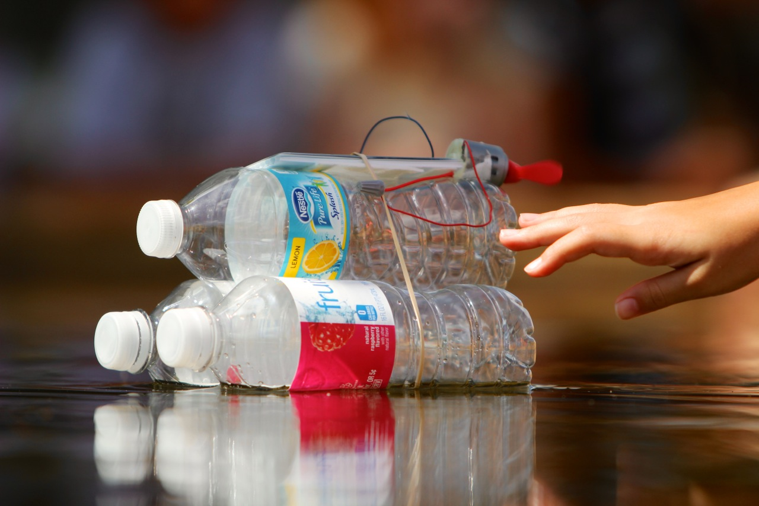
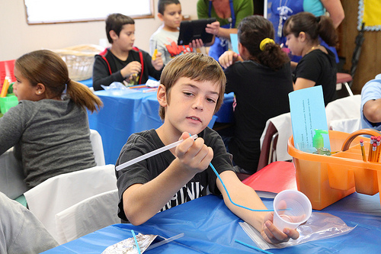
Step 4: Materials & Procedure
The purpose of the procedure is so other scientists and engineers can replicate your investigation. DETAIL, DETAIL, DETAIL.
Make sure to share all steps completed during the investigation and/or design of the invention.
It is okay if you begin your procedure and realize you may need to change something. This happens to scientists and engineers all the time.

Slide 16
Step 5: Decide how you will Collect Data
As you investigate your problem, be sure to collect data using a chart or table in your lab notebook.
This will help you draw conclusions when you are finished with your experiment
Sample Data Tables:

Slide 17
Step 6: Carry out the investigation
5 trials
Take notes
Record date and time
Be sure to collect data (measurements) and record in data table.

Slide 18
Steph 7: Graphing Results: Communicating Data (Graph can be hand drawn or computer generated.)
Types of Graphs:
Bar- Compares different things
Line- Shows progress over time
Circle- Parts of a Whole
Make sure title and subtitles are labeled.
Number of paper towels
Number of Ounces Absorbed

Slide 19
Step 8: Conclusion and Abstract: Putting It All Together
What did you learn from the experiment?
Did you prove your hypothesis?
Why-why not?
What problems did you have?
How is it applicable to real life?
What can the results be used for?
How can I use the knowledge I have gained from the experiment?
What would you do differently next time?

Slide 20
Final Step: Create a Backboard Display
This step is optional only if a student does not want to compete in the school fair. If the student would like a chance to compete at the school level and possibly the district level, a backboard display is required.
The backboard should include all the components of the science and engineering project.
See next slide for a sample backboard.

Slide 21
Sample Backboard

Slide 22
Projects Due Monday, December 9, 2019 Each classroom teacher will choose one participant who will compete in the school showcase during the week of December 16th.
Pasco County Showcase
Saturday, February 1, 2020
The top 8 participants will compete in the district showcase.

